Slide 1
Functions
CS 236
Fall 2023

Slide 2
Overview and Due
Functions
Definition
Notation
Partial Functions
Injections, surjections, bijections
Inverses
Due
Project 0 due Today
Homework 2 due Friday
Project 1 due Thursday, Sept 28

Slide 3
Slides for flipped class

Slide 4
Function Notation
Notation | (x, y) ∈ f | f : x→y | y = f(x)
Example | (2, β) ∈ f | f : 2→β | β = f(2)
f = {(1, α), (2, β), (3, β)}
Every element of {1,2,3} is mapped to a single value
1
α
2
β
3
γ

Slide 5
Function Notation
Notation | (x, y) ∈ f | f : x→y | y = f(x)
Example | (2, β) ∈ f | f : 2→β | β = f(2)
f = {(1, α), (2, β), (3, β)}
Every element of {1,2,3} is mapped to a single value
1
α
f is a function that maps the set {1,2,3} to the set {α, β,𝛾}
2
β
3
γ

Slide 6
What gets mapped where?
range
A: domain
B: codomain

Slide 7
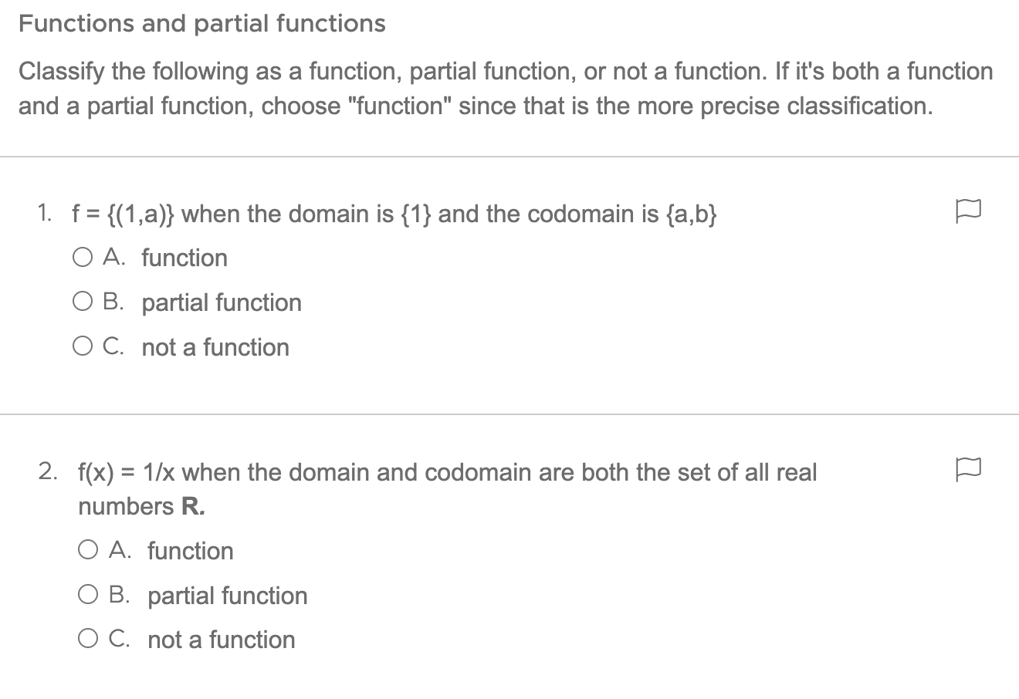
Not a function
1
α
2
β
Function
3
γ
1
α
2
β
Partial function
1
α
3
γ
2
β
3
γ

Slide 8
Not a function
1
α
2
β
Function
3
γ
1
α
2
β
Partial function
1
α
3
γ
2
β
3
γ

Slide 9
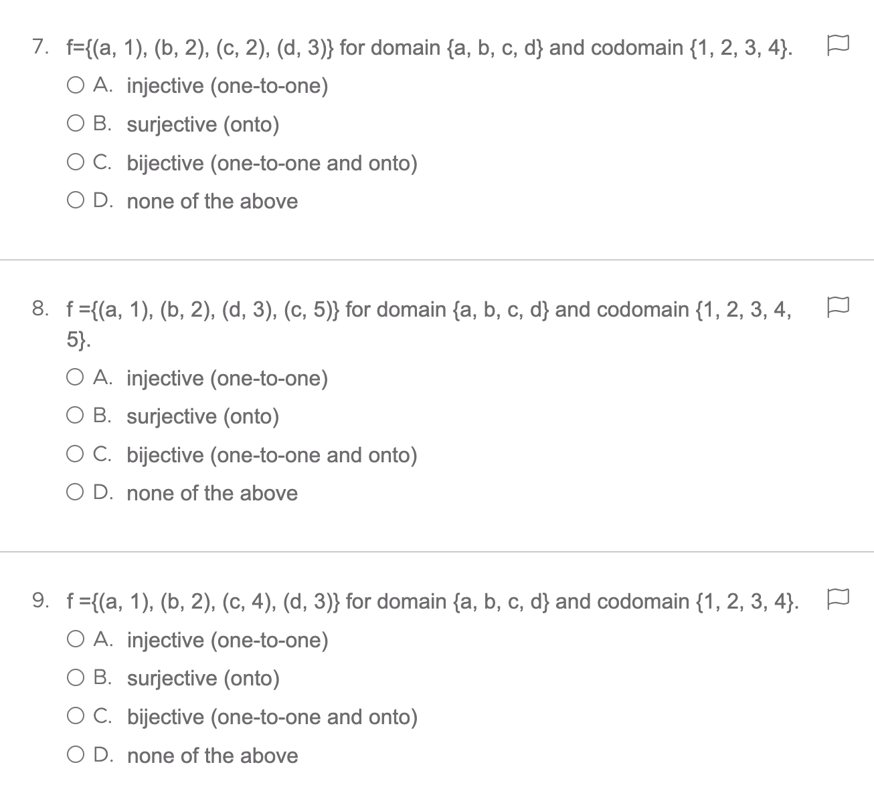
Injective
NOT Injective
1
a
1
a
b
b
2
2
c
c
3
d
3
d
In-jective → Un-jective → Un-ique
Does every student have a unique netID?

Slide 10
Injective
NOT Injective
1
a
1
a
b
b
2
2
c
c
3
d
3
d
In-jective → Un-jective → Un-ique
Does every student have a unique netID?

Slide 11
Injective
NOT Injective
1
a
1
a
b
b
2
2
c
c
3
d
3
d
In-jective → Un-jective → Un-ique
Does every student have a unique netID?

Slide 12
Surjective
NOT Surjective
1
a
1
a
2
2
b
b
3
3
4
c
4
c
Sur-jective → Sur-name
Are all legal surnames used?

Slide 13
Surjective
NOT Surjective
1
a
1
a
2
2
b
b
3
3
4
c
4
c
Sur-jective → Sur-name
Are all legal surnames used?

Slide 14
Surjective
NOT Surjective
1
a
1
a
2
2
b
b
3
3
4
c
4
c
Sur-jective → Sur-name
Are all legal surnames used?

Slide 15
Bijective
Neither surjective nor injective
1
a
1
a
2
2
b
b
3
3
c
4
c
Bijective → both injective and surjective

Slide 16
Bijective
Neither surjective nor injective
1
a
1
a
2
2
b
b
3
3
c
4
c
Bijective → both injective and surjective

Slide 17
Bijective
Neither surjective nor injective
1
a
1
a
2
2
b
b
3
3
c
4
c
Bijective → both injective and surjective

Slide 18
Slides I would have Used if we had had a regular lecture

Slide 19
Functions in Computer Science
Functions can be the kinds of mathematical objects that we’ve experienced in math classes for years, and
Functions can also be programming functions, methods, routines.
In CS, functions can differ from the mathematical functions used in math classes

Slide 20
Function Definition
Definition 1 in §2.3.1
Let A and B be nonempty sets. A function from A to B is an assignment of exactly one element of B to each element of A.
We write f(a) = b if b is the unique element of B assigned by the function f to the element a of A

Slide 21
What is a Function
A function from A to B is an assignment of a unique element from B to each element of A.
We write a function as
For a function, every element of A has exactly one element from B assigned to it.
For a partial function, some elements of A have no assignment

Slide 22
Functions
f = {(1, α), (2, β), (3, β)}
Every element of {1,2,3} is mapped to a single value
1
α
2
β
3
γ
f = {(1, α), (2, β), (3, γ)}
Every element of {1,2,3} is mapped to a single value
1
α
2
β
3
γ

Slide 23
Functions
y
Every real number in the interval [0,1] is mapped to a single real value
x
0
1

Slide 24
NOT Functions
1
α
2
β
f = {(1, α), (2, β), (3, β), (3, γ)} uniqueness violated for 3 ⎯ which is mapped to two values
3
γ
y
Uniqueness violated for some x’s
x

Slide 25
Partial Functions
1
α
f = {(1, α), (2, β)} f not defined for input 3
2
β
3
γ
y
Some x’s do not have corresponding y’s
x

Slide 26
Notation for Functions
We can use various notations for functions: for f = {(1, α),(2, β),(3, β)}
Notation | (x, y) ∈ f | f : x→y | y = f(x)
Example | (2, β) ∈ f | f : 2→β | β = f(2)

Slide 27
Domain, Co-Domain, Range Definition –§2.3.1
Definition 2 in the textbook
f : A → B
A is the domain: possible “inputs” to the function
B is the codomain: possible “outputs” from the function
The range of f is the set of all elements of B that are assigned to elements from A.

Slide 28
range
A: domain
B: codomain

Slide 29
range = {A,B,C}
Jim
A
Ann
B
Bob
C
Sue
Pat
D
E
A: domain
B: codomain
assignment = {(Jim,B),(Ann,A), (Bob,C), (Sue,B), (Pat,A)}

Slide 30
Practice
Given domain A and codomain B, classify each relation as a total function, a partial function, or not a function
A = {1,2,3,4}, B = {a,b,c}
F1 = {(1,a), (2,b), (3,b)}
F2 = {(2,a), (2,b), (2,c)}
F3 = {(1,b),(2,b),(3,a),(4,a)}
F4 = {(1,b),(2,a), (3,c), (4,a), (2,b)}

Slide 31
Practice
Given domain A and codomain B, classify each relation as a total function, a partial function, or not a function
A = {1,2,3,4}, B = {a,b,c}
F1 = {(1,a), (2,b), (3,b)} partial
F2 = {(2,a), (2,b), (2,c)} not
F3 = {(1,b),(2,b),(3,a),(4,a)} total
F4 = {(1,b),(2,a), (3,c), (4,a), (2,b)} not

Slide 32
Definitions --§2.3.2
Injection (one-to-one)
Surjection (onto)
Bijection (one-to-one and onto)
We will only consider these definitions for total functions

Slide 33
Injection, one-to-one
Injection: “one-to-one” or “1-1”
∀x∀y(f(x) = f(y) ⇒ x = y)
For f : A → B, the elements in B are “hit” at most once
Injective
NOT Injective
1
a
1
a
b
b
2
2
c
c
3
d
3
d
y
y
x
x

Slide 34
Problem
Given a domain A={1,2,3,4,5} and codomain B={a,b,c,d}, is it possible to create a function, f : A → B, that is injective?

Slide 35
Problem
Given a domain A={1,2,3,4,5} and codomain B={a,b,c,d}, is it possible to create a function, f : A → B, that is injective?
No, because there are more elements in the domain than the codomain
We could create an injective function for f : B → A

Slide 36
Surjection-- onto
Surjection: “onto”
∀y∃x(y = f(x))
For f : A → B, the elements in B are all “hit” at least once
Surjective
NOT Surjective
1
a
1
a
2
2
b
b
3
3
4
c
4
c
y
y
{
not “hit”
x
x

Slide 37
Problem
Given a domain A={1,2,3,4,5} and codomain B={a,b,c,d}, create a function, f : A → B, that is surjective (all elements in B are hit at least once)

Slide 38
Problem
Given a domain A={1,2,3,4,5} and codomain B={a,b,c,d}, create a function, f : A → B, that is surjective (all elements in B are hit at least once)
There are many possible answers
Here is one: {(1,d), (2,c), (3,b), (4,a), (5,d)}

Slide 39
Bijection
Bijection: “one-to-one and onto” or “1-1 correspondence”
∀x∀y(f(x) = f(y) ⇒ x = y) ∧ ∀y∃x(y = f(x))
For f : A → B, every B element is “hit” once and only once
NOT Surjective
NOT injective
Bijective
NOT Bijective
1
a
1
a
2
2
b
b
3
3
c
4
c
y
y
x
x

Slide 40
Problem
Given a domain A={1,2,3,4} and codomain B={a,b,c,d}, classify each function as an injection, surjection, bijection, or none.
F5 = {(1,b), (2,b), (3,a). (4,c)}
F6 = {(1,c), (2,b), (3,d), (4,a)}
F7 = {(1,a), (2,c), (3,a), (4,d)}
F8 = {(1,a), (2,b), (3,c)}

Slide 41
Problem
Given a domain A={1,2,3,4} and codomain B={a,b,c,d}, classify each function as an injection, surjection, bijection, or none.
F5 = {(1,b), (2,b), (3,a). (4,c)} none
F6 = {(1,c), (2,b), (3,d), (4,a)} bijection
F7 = {(1,a), (2,c), (3,a), (4,d)} none
F8 = {(1,a), (2,b), (3,c)} injection

